Slide 1

G2M Insight for Cab Investment Firm
Virtual Internship
Ece Yavuzyılmaz
21-May-2023

Slide 2

Agenda
Problem Statement
Data Information
Exploratory Data Analysis (EDA)
Hypothesis tests
Recommendations

Slide 3
Problem Statement
XYZ is a private equity firm in US. Due to remarkable growth in the Cab Industry in last few years and multiple key players in the market, it is planning for an investment in Cab industry.
Objective : Provide actionable insights to help XYZ firm in identifying the right company for making investment.
The analysis has been divided into four parts:
Data Understanding
Forecasting profit and number of rides for each cab type
Finding the most profitable Cab company
Recommendations for investment

Slide 4
Data Information
The dataset contains four different csv files. These datasets were combined in the 'all_data.csv' file after reviewing.
Cab_Data.csv : This file includes details of transactions for 2 cab companies (9 features).
Customer_ID.csv : This is a mapping table that contains a unique identifier that links the customer’s demographic details (4 features).
Transaction_ID.csv : This is a mapping table that contains transaction to customer mapping and payment mode (3 features).
City.csv: This file contains a list of US cities, their population, and the number of cab users (3 features).
All_data.csv: This file is a combination of 4 files. The dataset is combined based on the "Customer ID" and "Transaction ID" features. Also, new features such as profit, state have been added to the dataset (16 features).

Slide 5
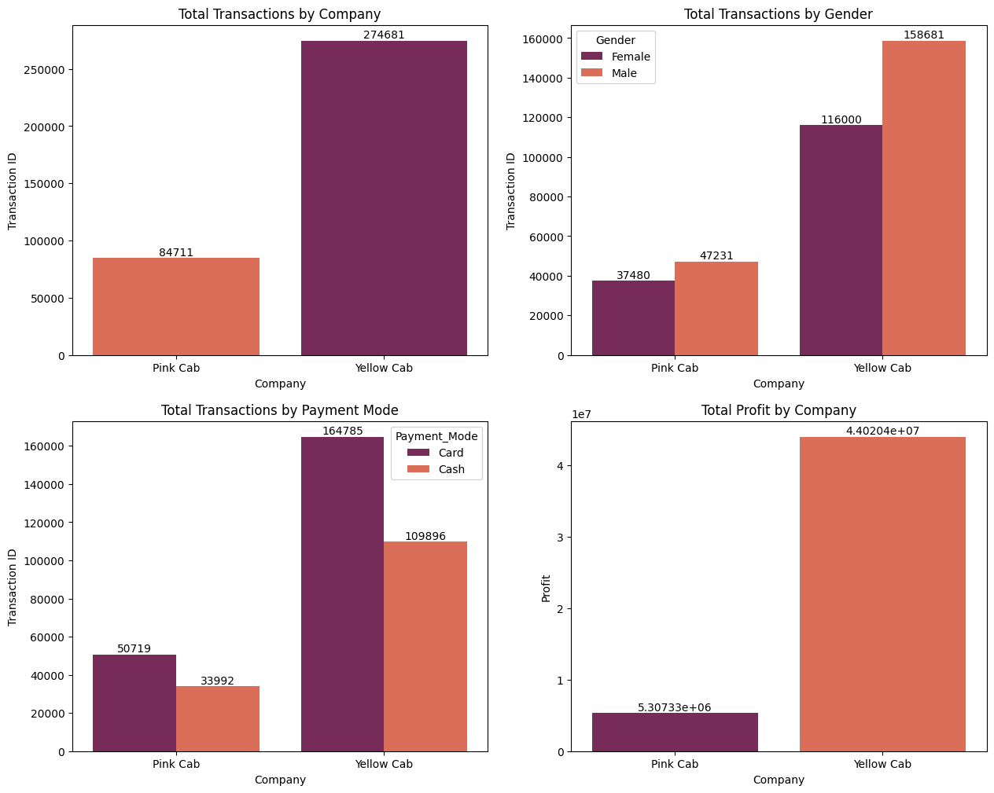
Exploratory Data Analysis (EDA)
Here, the total transactions by cab companies and gender is shown.

Slide 6
Exploratory Data Analysis (EDA)
Here, the total transaction by payment mode and total profit by company is shown.

Slide 7
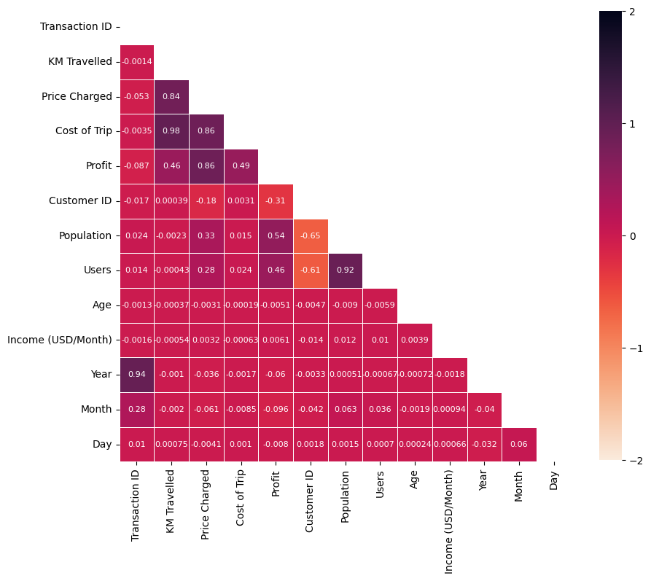
Exploratory Data Analysis (EDA)
The two features with the strongest correlation in the dataset are 'KM Traveled' and 'Cost of Trip' with 0.98.
It is seen that there is a strong positive correlation with 0.92 correlation between 'Population' and 'Users' features.

Slide 8
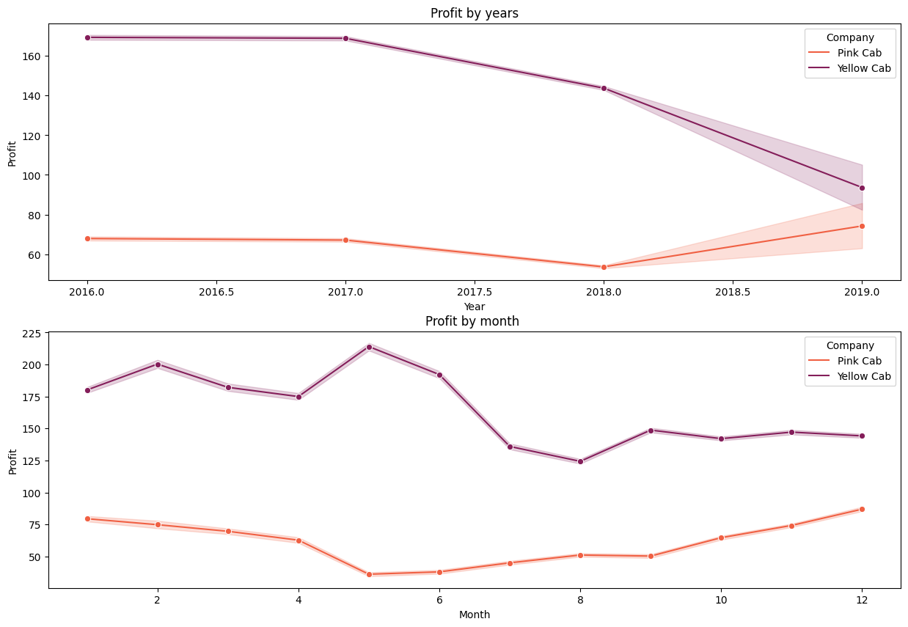
Exploratory Data Analysis (EDA)
Profits of cab companies on a monthly and annual basis

Slide 9
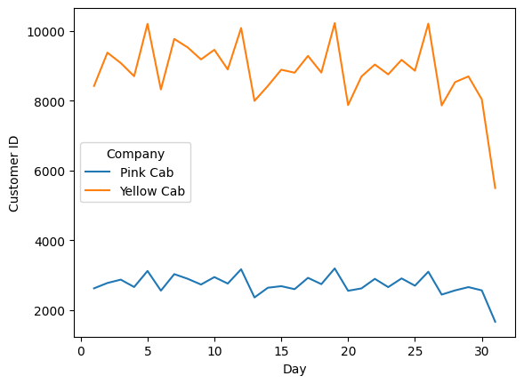
Exploratory Data Analysis (EDA)
It is seen that the demand is higher on the third day of the week for both companies.

Slide 10
Exploratory Data Analysis (EDA)
It is seen that the demand is higher on the third day of the week for both companies.

Slide 11
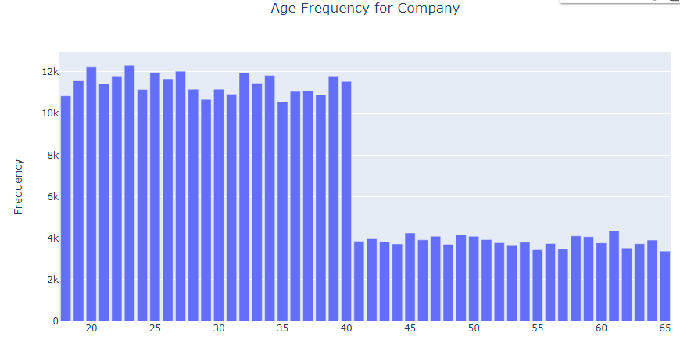
Exploratory Data Analysis (EDA)
It is seen that the customer age distribution in both companies is between 20 and 40.

Slide 12
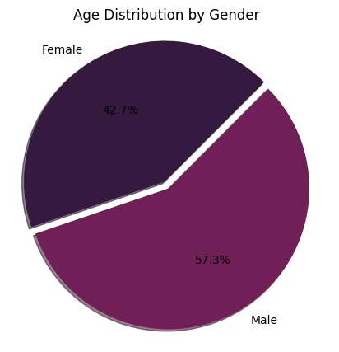
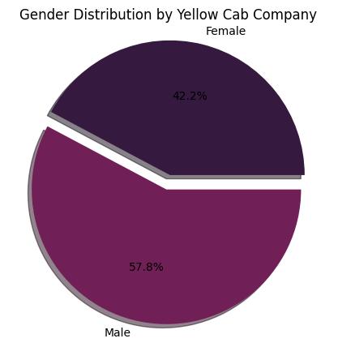
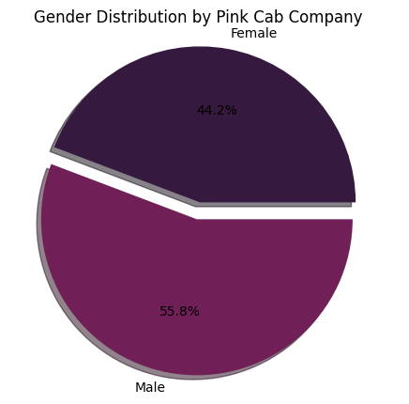
Exploratory Data Analysis (EDA)
Gender distribution by cab company.

Slide 13
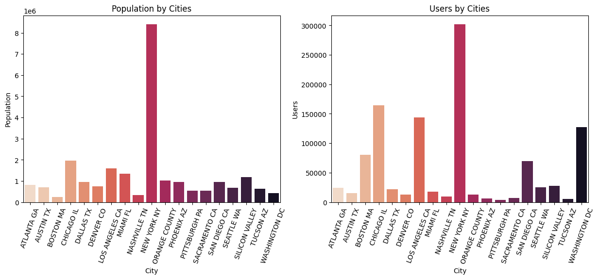
Exploratory Data Analysis (EDA)
Population and user distribution by cities.

Slide 14
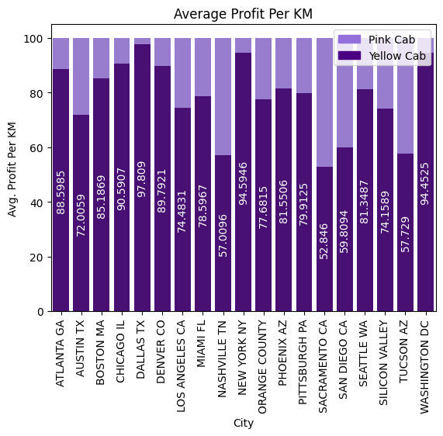
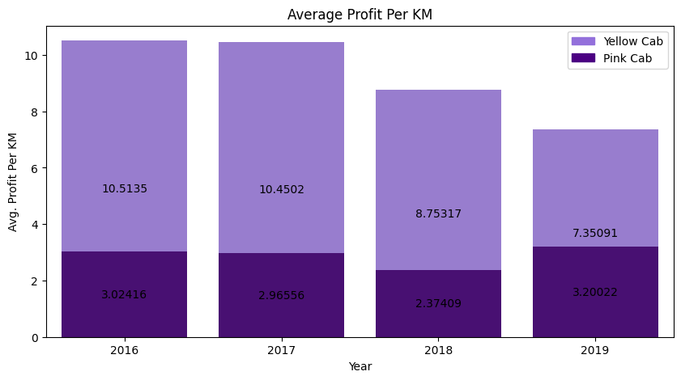
Exploratory Data Analysis (EDA)
Profit distribution of cab companies by cities and years.

Slide 15
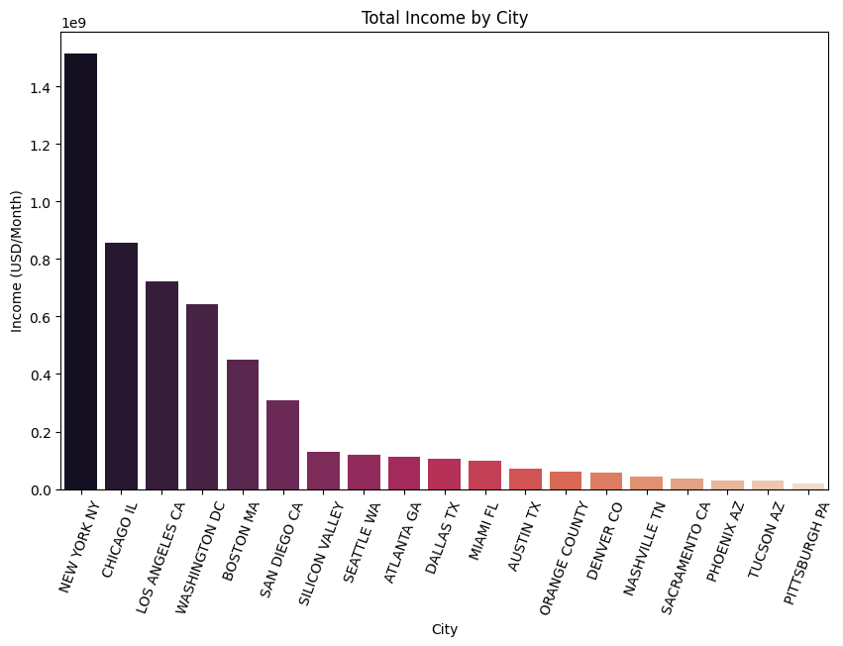
Exploratory Data Analysis (EDA)
Maximum total income is new york city.

Slide 16
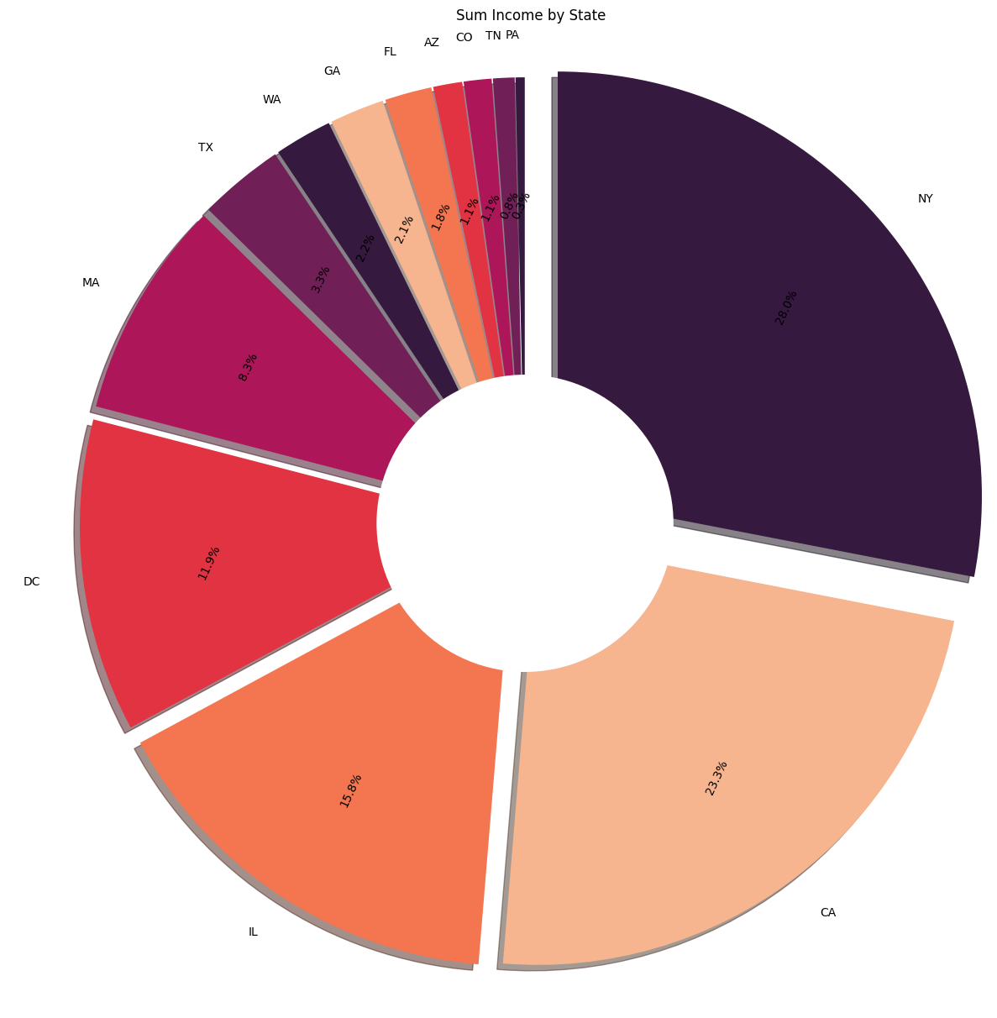
Exploratory Data Analysis (EDA)
Income distribution by state.

Slide 17
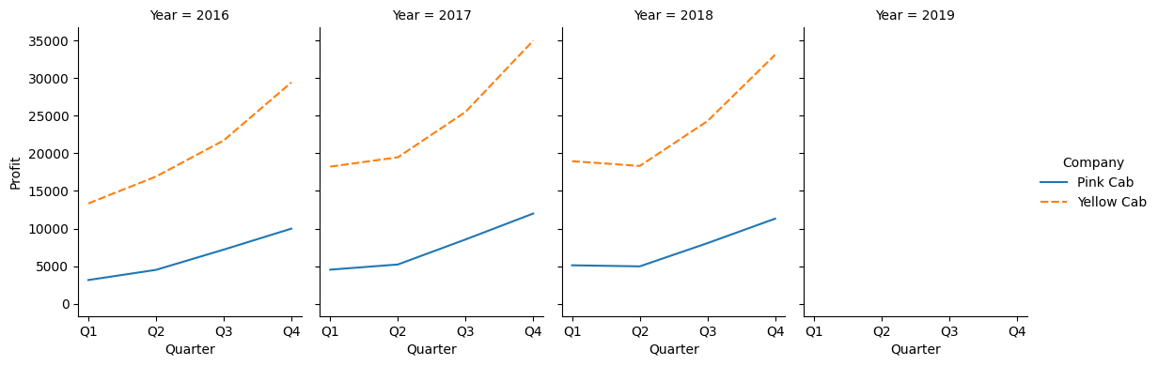
Exploratory Data Analysis (EDA)
Seasonal pattern 4 quarter cycle by Profit.

Slide 18
Exploratory Data Analysis (EDA)
Seasonal pattern 4 quarter cycle by Profit.

Slide 19
Hypothesis tests
t_statistics: [-0.03834307] p_value: [0.97289731] Reject Alternative Hypothesis(H1) t_statistics: [0.17875066] p_value: [0.8746019] Reject Alternative Hypothesis(H1)
KodMetin
Hypothesis 1:
H0:Gender has not effect on company profit H1:Gender has effect on company profit
Hypothesis 2:
H0:Payment mode has not effect on company profit H1:Payment mode has effect on company profit
'Pink Cab’
t_statistics: [0.02786795]
p_value: [0.98029821]
Reject Alternative Hypothesis(H1)
‘Yellow Cab’
t_statistics: [-0.08386648]
p_value: [0.94080144]
Reject Alternative Hypothesis(H1)
'Pink Cab’
t_statistics: [-0.03834307]
p_value: [0.97289731]
Reject Alternative Hypothesis(H1)
‘Yellow Cab’
t_statistics: [0.17875066]
p_value: [0.8746019]
Reject Alternative Hypothesis(H1)

Slide 20
Hypothesis tests
t_statistics: [-0.03834307] p_value: [0.97289731] Reject Alternative Hypothesis(H1) t_statistics: [0.17875066] p_value: [0.8746019] Reject Alternative Hypothesis(H1)
KodMetin
Hypothesis 3:
H0:The variable Year has not a positive correlation with mileage H1:The variable Year has a positive correlation with mileage
Hypothesis 4:
H0:Age has not effect on company profit H1:Age has effect on company profit
'Pink Cab’
t_statistics: [-0.66243408]
p_value: [0.57581736]
Reject Alternative Hypothesis(H1)
‘Yellow Cab’
t_statistics: [-0.42772975]
p_value: [0.71050085]
Reject Alternative Hypothesis(H1)
'Pink Cab’
t_statistics: [0.13340069]
p_value: [0.90608835]
Reject Alternative Hypothesis(H1)
‘Yellow Cab’
t_statistics: [-0.50355161]
p_value: [0.66456451]
Reject Alternative Hypothesis(H1)

Slide 21
Hypothesis tests
t_statistics: [-0.03834307] p_value: [0.97289731] Reject Alternative Hypothesis(H1) t_statistics: [0.17875066] p_value: [0.8746019] Reject Alternative Hypothesis(H1)
KodMetin
Hypothesis 5 :
H0:There is seasonality in the number of customers using the cab service. H1:There is not seasonality in the number of customers using the cab service.
Seasonal_Mann_Kendall_Test (trend='increasing', h=True, p=7.923130374010157e-09, z=5.770085540729481, Tau=0.9090909090909091, s=120.0, var_s=425.3333333333333, slope=1.0, intercept=9196.25)

Slide 22
Recommendations
As a result, it is seen that the yellow cab is better than the pink cab.
When both cab companies are compared, it is seen that the yellow cab is much more successful
average profit per km,
user,
income,
customer retention,
customer access.

Slide 23
Thank You

